Slide 1
Paperless Office
A paperless office is a concept of work environment in which the use of paper is eliminated or greatly reduced.
This is achieved through converting documents and other papers work into digital forms.
We can extend it to outside of office to make it more useful.

Slide 2
Motivation
Motivation For choosing this objective is the concern for reducing the consumption of natural resources such as wood ,water etc.
Implementation of this objective will reduce the human efforts as well as it will be ease in accomplishment of task.

Slide 3
Aim & Objective
Delivering this project our aim is to increase productivity, reduce Human efforts, reduce time and cost and make process easier.
Design a customizable workflow management system to handle submission and approval.

Slide 4
Abstract
We are developing system for non-tender projects of construction organization.
In current system for getting project construction organizations need to search on different advertisement and for application form they need to go central office and submit documents with forms. For completing process, they need to go their more than one time.
We proposed system that complete all process at one place we will build web application were all new project are displayed from this portal both government officer and organization do their side work and complete it.

Slide 5
Summary of Research Papers

Slide 6
Paper Name | Author | Publication year | Methods use | Advantage | Limitation
An analysis of the feasibility of a paperless environment – the case of the Mona school of business | Mardene Rosalee Carr | 2005 | literature review as well as questionnaire (Surveys) | A less paper environment is a more realistic achievement at the Mona School of Business. | More specific for Mona school of business.
Electronic Document Management System for Kirikkale University. | Mustafa Başıbüyük and Atilla Ergüzen. | 2015 | Several studies have been carried out for more efficient document management systems in the universities of Turkey and world. | Everything is described in detail with implementation information such as tools used in EDMS. | Here, limited IT tools & technology is mentioned weather more tools are available to create EDMS (Electronic Document Management Systems)
Document Security in Web Applications | Andres Desa | 2005 | Several Information Security mechanisms have been used to securely store and retrieve the documents. | We can store and retrieve document securely | Depend on the type of web browser

Slide 7
Web-based paperless campus: an approach to reduce the cost and complexity of education Administration | Hastrup A. Victor, Lawal N. Olawale, Yekini N. Asafe. | 2014 | literature review and research study. | Author Discuss E-administration systems for schools and colleges, one can get idea about components needed to Design Paperless office. | There is a need to intensify the public enlightenment program about the need for web-based e-administration system within schools and colleges so that everybody will be acquainted with the system before its implemented, since it will affect everybody.
Challenges for The Quality of Information in the Paperless Office | Mircea Georgesku , Alexandru Tugui, Florin Dumitriu | 2008 | Discussions and Research study | Discuss types of document-oriented systems in incredibly detailed manner and describe components that every document-oriented system should have. | No clue about first cost associated with the purchase of a paperless filing Modifications/changes to documents or files.
Design and Implementation of Paperless Office System | Busheng Li and Jingfang Hu | 2017 | In this paper Author divide office in different module and different users, different access permission | system, management, reduce managements, increase management efficiency, increase economic benefits | No implementation about relationship between tables, data redundancy control

Slide 8
Web Server Security and Survey on Web Application Security | Shaikh Bushra Almin | 2014 | Describe different types of attacks on web applications and web servers | How to prevent from the different attack | Not described which tools and technology used for the achieve the security
Perusal of Web Application Security Approach | Ashikali M Hasan, Divyakant T. Meva, Anil K Roy, Jignesh Doshi | 2017 | Apply security on different layers | Give information about different approach to secure the applications and different method to check Vulnerability | No limitation in this paper
Implementing a Paperless System for Small and Medium-Sized Businesses (SMBs) | Chad Chao | 2015 | Research on paperless and paper-based articles and keywords-based result | They pointed solution for Small and medium business to become paperless | Obstacles are mind set of all or nothing and employee resistance and police of organization and lack of knowledge

Slide 9
Paperless Office: a new proposal for organizations | Sandra-Dinora, Alejandro, Graciela | 2015 | Document management, Workflow study, E-administration. | - Decreased costs -Decreased response time, increasing the speed of service. | implementation processes, especially technical and cultural changes about attitude and aptitude towards modern technologies.
The features and impact of the paperless office, with specific reference to the City of Johannesburg | M. Hattingh (Midrand MLC, Midrand, South Africa) | 2001 | -Enabling technologies: Documents must be put into a computer-readable format before they can be stored electronically. -Enabling technologies that aid in the electronic management of documents include scanners that use image technology. | -Electronic documents can be stored and delivered in various forms and formats, and delivered as a package to the user as, when, and how required. | The paper-based file storage system at the Town Planning Information Counter are slow, cumbersome, and error-prone. Furthermore, it does not support the principles of local government for efficient service delivery.
Networking of Paperless Offices in Technical Institutes of India | Seema Shah, Mohit Tiwari | 2010 | literature review as well as questionnaire (Surveys) | Author pointed to use ICT tools in managerial sector, communication, record kipping | Applied rules and regulation are not up to the date with new generation IT Tools and technology

Slide 10
Role of Paperless Procedures in Achieving Working Style Reform | Yuki Aoyama Nobuko Soga Kenji Shinotsuka Naoya Oike Manami Fukumoto | 2018 | importance of paperless procedures and the utility of RPA, using case studies | RPA with paperless Document, New work style | Small organization are not able to take benefits of RPA as they needed resources, and special skill
End of the paper trail: moving towards a paperless ward round | Jack harvey, Max pickard, Mohammed NuNhuck | 2008 | Use Microsoft word template for record | system use full for small individual to make them self-paperless | Confidentiality of user information, lack of proper software for small entities in organization
Real Time Databases for Applications | Sonam Khedkar, Swapnil Thube | 2017 | Compare the database with each other | Give the information about different real time database | Not give the application where we can use database

Slide 11
Paperful to Paperless Office Forms Integration Framework | Madhuri Potu | 2004 | Author use the Xform, JavaScript and JSP for creating the xml form | Using this form data and presentation are independent from each other. We can use Predefine template, edit them and make user define form. | Only consider few components for the make form and there is no technic for retrieve the data from the database to form
Analysis of Security Issues in Electronic Payment Systems | Princewill Aigbe, Jackson Akpojaro | 2014 | It provides a review of the various online payment systems. Analyze the various authentication mechanisms of the online payment systems and levels of confidence each provides. | This paper presents a complete review of the different categories of electronic payment systems in terms of online payment processes, authentication mechanisms, and authentication types. | the three-factor authentication model; including biometric (finger-vein) to design an enhanced algorithm for electronic payment systems whose authentication’s capability would surpass the existing online payment system but here They have not explored it.
Office of the Future: Digitizing Record-Keeping | Okoro U. R., Awodele O., Kuyoro S. O. and Adekunle Y.A. | 2013 | Window application | It is useful for individual and small organization for record keeping | No facility for sharing records and Use of scanner for digitizing records

Slide 12
Going paperless - on the evaluation of electronic form technologies | Lutteroth & Weber. | 2012 | Study Evaluation of form technology and discussed methods for Going paperless by electronic forms. | Discussed that electronic forms have many advantages, such as the possibility to transfer, store, complete, search and manage them more efficiently The authors identified some requirements that must be met for electronic forms to be successful. | Our results show that current technologies differ greatly in the requirements that are addressed, and that no single form technology satisfies all the common requirements.
Practical Application Challenges for Construction Submittals in a Paperless Contract File | P. Tod Smyrichinsky, Meng, P.E. and Scott W. Kramer. | 2018 | questionnaire (Surveys) as well as discussions | One can get idea about how to transform paper based to paperless system for large organization incorporating multiple requirements and constraints with multiple users. | No Implementation of a fully functional RMS 3.0.

Slide 13
System Flow Diagram

Slide 14
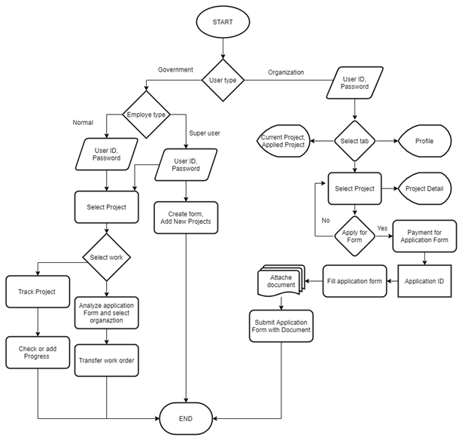

Slide 15
Use Case Diagrams

Slide 16
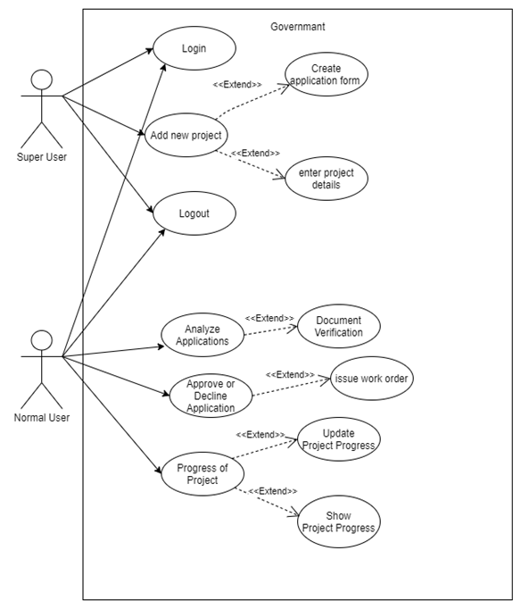

Slide 17
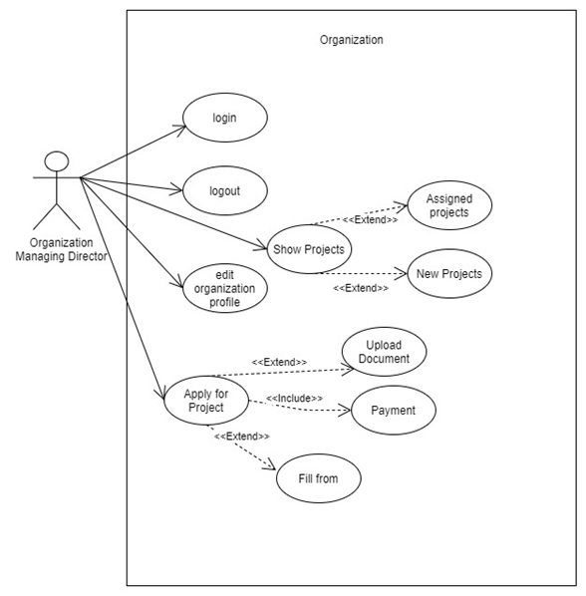

Slide 18
Class Diagram

Slide 19
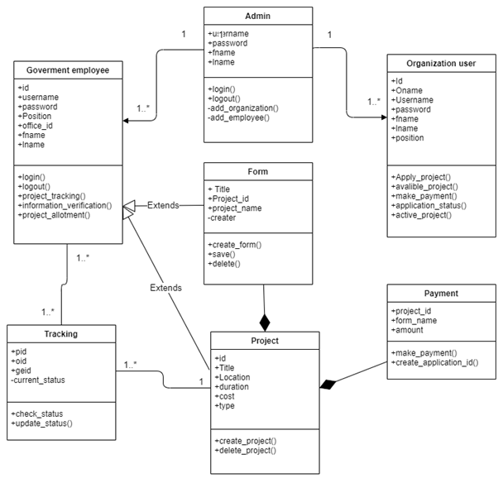

Slide 20
Activity Diagram

Slide 21
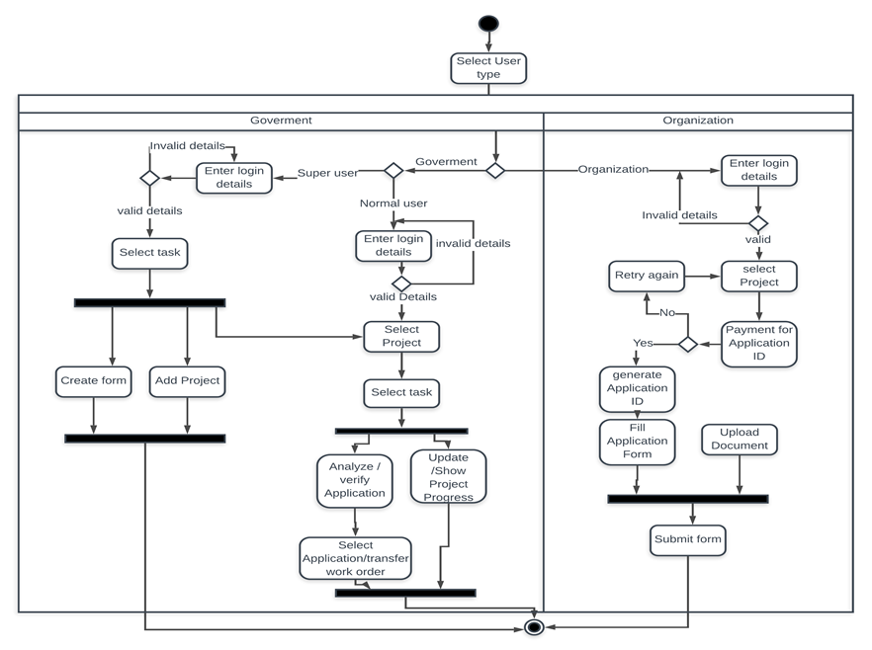

Slide 22
Data Flow Diagrams

Slide 23
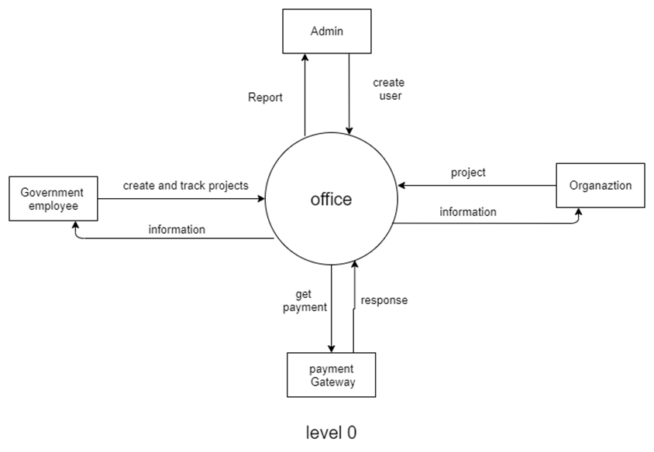

Slide 24
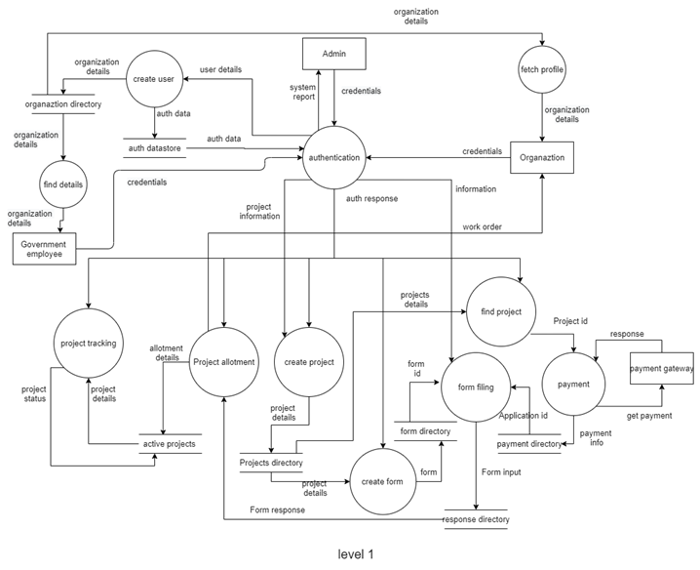

Slide 25
Entity Relationship Diagram

Slide 26
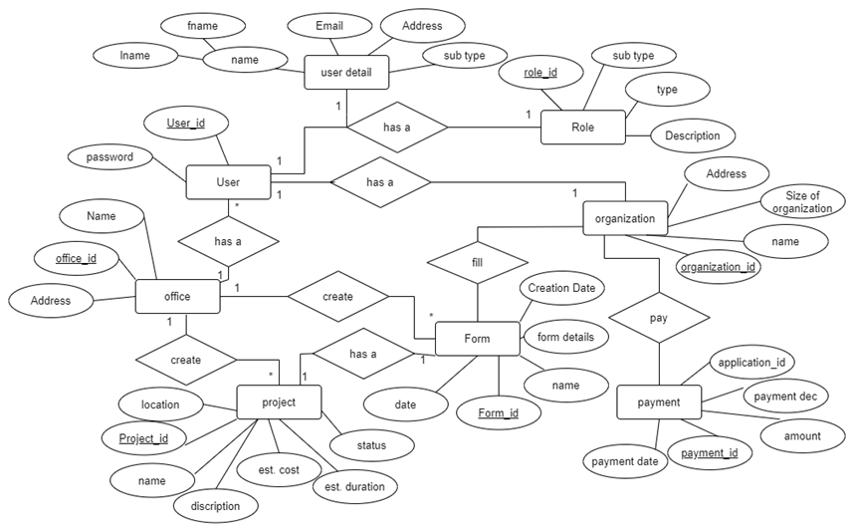

Slide 27
Implementation Snapshots

Slide 28
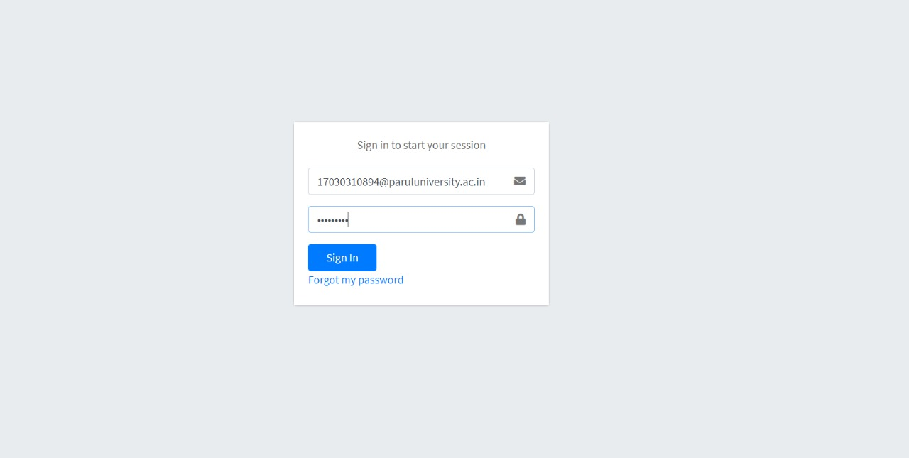

Slide 29
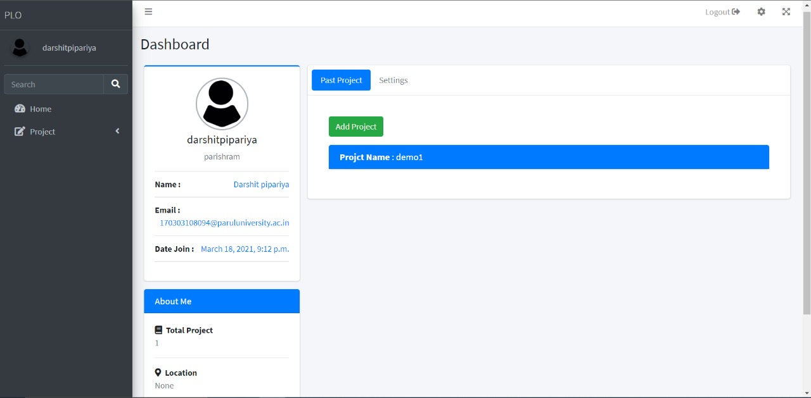

Slide 30
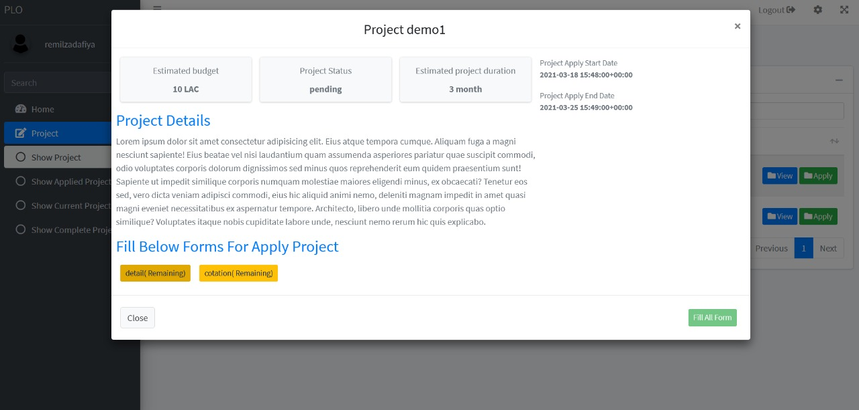

Slide 31
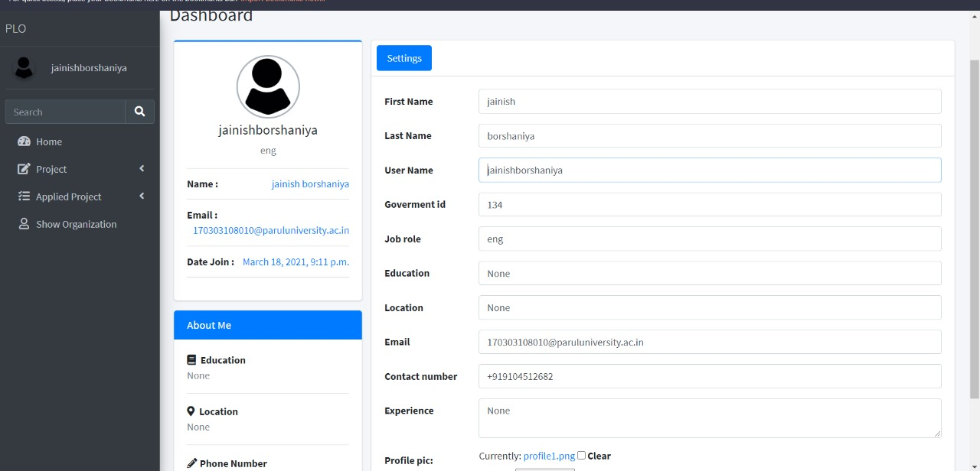

Slide 32
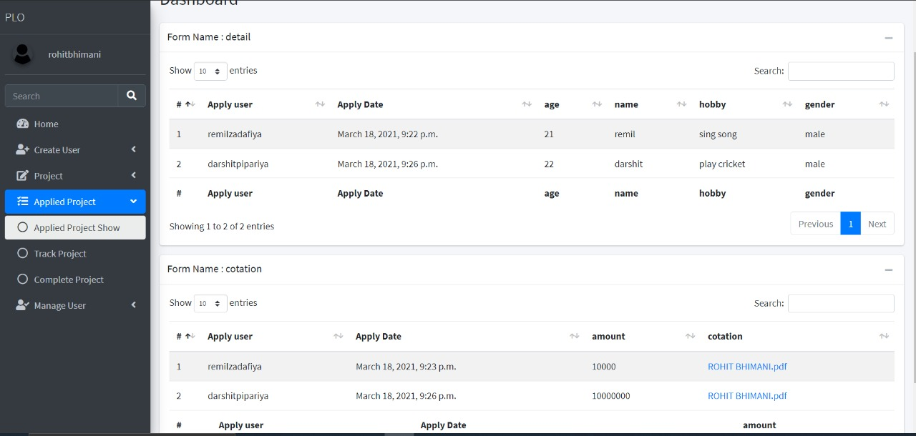

Slide 33
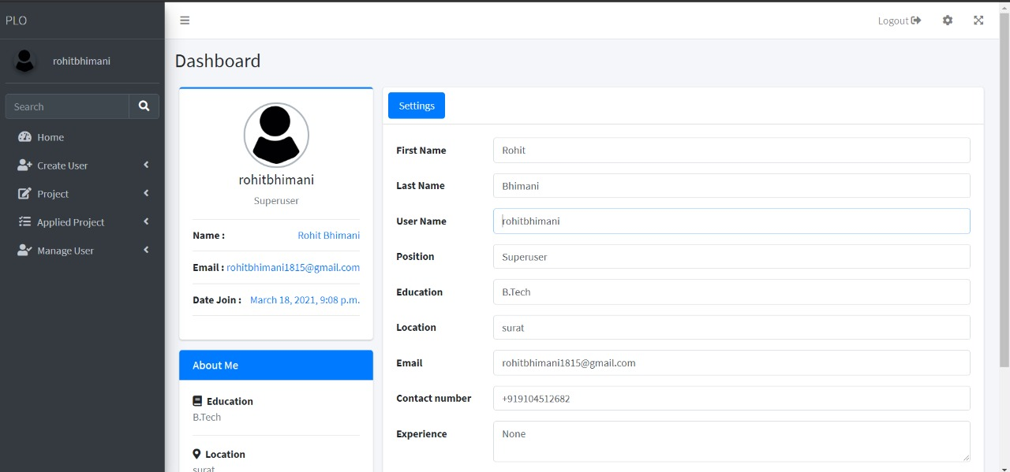

Slide 34
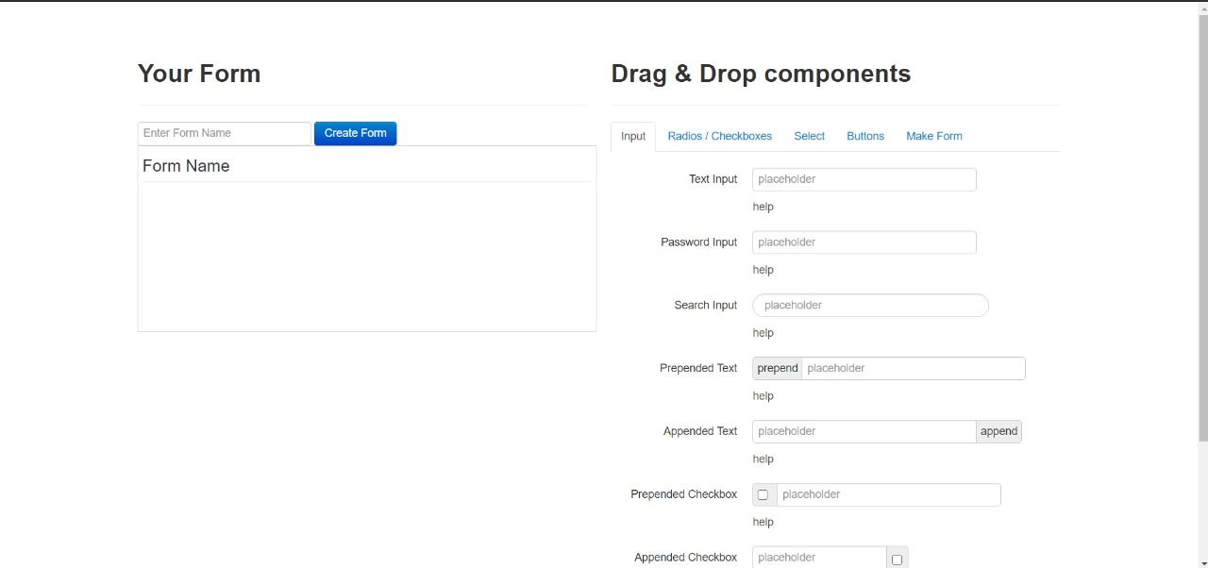

Slide 35
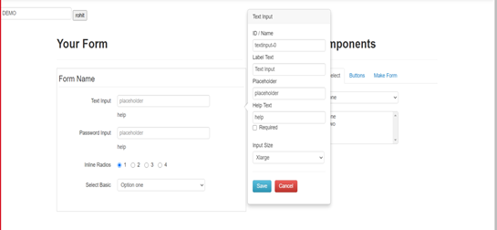

Slide 36
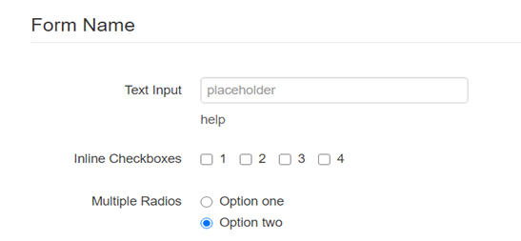

Slide 37
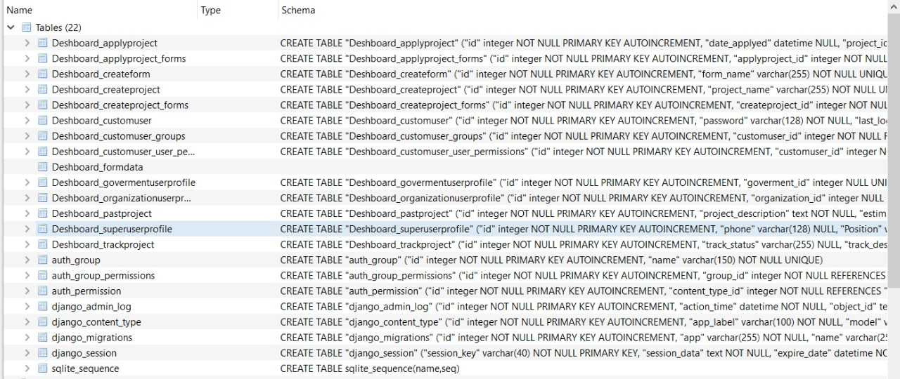

Slide 38
Advantages
Easy access to information
Saving in time and fuel
Simplify business processes
More time to focus on business
Save money and office space
More environment friendly
Easy to filling ,storing and retrieval of information
Quick Response of query

Slide 39
Conclusion
Based on past research that has been done on ‘Paperless office’, we are able to get required information about workflow, design and implementation for our project. Paperless office idea comes into reality by implementing web application that satisfy our objectives and functional requirement. The application is not only Environment friendly but also time saving & cost reducing for both construction organization and Gujarat water supply & Sewerage Board.

Slide 40
References
1) Başıbüyük, M. & Atilla E. December 2015. Electronic Document Management System for Kirikkale University. Unified Journal of Computer Science Research 1(2) pp. 008-015.
2) Li, B. & Hu, J., 2017. Design and Implementation of Paperless Office System. In: second International Conference on Manufacturing Science and Information Engineering , 2017.
3) Aigbe, P.W.& Akpojaro, J., 2014. Analysis of Security Issues in Electronic Payment Systems. International Journal of Computer Applications, 108, 10.
4) Almin, S., 2014. Web Server Security and Survey on Web Application Security. International Journal on Recent and Innovation Trends in Computing and Communication, 2(1), pp. 114-119.
5) Khedkar, S. & Thube, S., 2017. Real time databases for applications, International Research Journal of Engineering and Technology, 4(6), pp. 2078- 2082.
6) Carr, M., 2005. An analysis of the feasibility of a paperless environment - The case of the Mona School of Business, Management of Environmental Quality: An International Journal, 16(4), pp. 286-290. 7) Orantes-Jiménez, S., Zavala-Galindo, A., & Vázquez-Álvarez, G., 2015. Paperless Office: A New Proposal for Organizations. Journal on Systemics, Cybernetics and Informatics, 13(3), 47-55.
7) Orantes-Jiménez, S., Zavala-Galindo, A., & Vázquez-Álvarez, G., 2015. Paperless Office: A New Proposal for Organizations. Journal on Systemics, Cybernetics and Informatics, 13(3), 47-55.
8) Hattingh, M., 2001, The features and impact of the paperless office, with specific reference to the City of Johannesburg, South African Journal of information Management. 3(3/4).

Slide 41
9) Hasan, A., Meva, D., Roy, A. & Doshi, J., 2017. Perusal of Web Application Security Approach. In: International Conference on Intelligent Communication and Computational Techniques (ICCT), Dec 22-23, 2017, Jaipur.
10) Georgesku, M. ,Tugui, A. & Dumitriu, F., 2008. Challenges For The Quality Of Information In The Paperless Office, Management of International Business and Economics Systems.807-817.
11) Lutteroth, C. & Weber, G.,2011. Going paperless - on the evaluation of electronic form technologies. In 2012 23rd International Workshop on Database and Expert Systems Applications. IEEE Computer Society, 14–18.
12) Victor, H.A., Olawale, L.N. & Asafe, Y.N., 2014., Web-Based Paperless Campus: An Approach To Reduce the Cost and Complexity OF Education. In 5th International Conference On “Software Solutions, E-Learning, Information & Communication Technology” (SEICT– 2014) Bursa,101-107.
13) Okoro U. R., Awodele O., Kuyoro S. O. & Adekunle Y.A., 2013. Office of the Future: Digitizing Record Keeping. International Journal of Computing Academic Research,2(2),pp. 75-87.
14) Potu,M.,2004., Paperful to Paperless Office Forms Integration Framework.
15) Harvey, J., Pickard, M. and Nunhuck, M. (2008) “End of the paper trail: moving towards a paperless ward round,” Psychiatric Bulletin, Cambridge University Press, 32(2), pp. 67–68.
16) Shah, S. & Tiwari, M. (2010). Networking of Paperless Offices in Technical Institutes of India. S International Journal of Computer Science and Network Security,10(3), pp. 177-181.
17) Aoyama, Y., Soga, N., Shinotsuka, K., Oike, N.& Fukumoto, M. (2018) Role of Paperless Procedures in Achieving Working Style Reform. Hitachi Review, 67(6), pp.758-759.
18) Desa, A.,2005., Document Security in Web Applications.
19) Chao, C.,2015., Implementing paperless System for Small and Medium sized Businesses (SMBs).
20) Smyrichinsky, P.T., Meng, P.E & Kramer, S.W., 2018., Practical Application Challenges for Construction Submittals in a Paperless Contract File. In: Creative Construction Conference 2018, CCC 2018, 30 June - 3 July 2018, Ljubljana, Slovenia.

